Slide 1
SHOOTING ARENA
Group 1:
CRN: 12676
Tejesh Bokam
Niranjan Reddy Vangala
Arun Kumar Reddy Kotha
Jahnavi Gujjula

Slide 2
Introduction
Our website consists of Administrator and Player modules. The administrator gets to login with the credentials. The administrator adds the venues where the games are to be organised. The administrator can view the venues added. Players get registered and login to the website. The players can view the games hosted by the admin and book the cabin with a choice of time schedule and complete the payment to book the slot. The administrator can view the history.

Slide 3
Objective of the project
To Provide a user friendly interface to book the slots and get entertainment without any effort.
The admin will add the shooting places and cabins ,the admin can view the shooting places and cabins.The admin can view the booking.The player can view the shooting places. The player can view the shooting cabins. The player can view the timing slots and book the slot. The player can cancel the booking. The player and admin can view the bookings.

Slide 4
Functional Requirements
The admin will get login with the default credentials.
The admin adds the shooting place.
The admin can view the shooting places that are added.
The admin will add the shooting cabins.
The admin can view the shooting cabins.
The admin will add the time slots for the cabins.
The admin can view the booking made.
The player gets registration and login to the system.
The player can view the places.
The player can view the cabins.
The player can book the cabin by choosing the time slot and making payment.
The player can view the bookings.

Slide 5
Admin
The administrator gets login with the default credentials. The administrator can add the shooting places into the system, the administrator can view the available shooting places.The administrator adds the cabins. The administrator can view the cabins added.The admin can view the booking. After completion, the admin make it as completed.

Slide 6
Player
The players get registered and login to the website.The players can view the games hosted by the admin..If the players are interested with the games,the players can book the slot after payment confirmation.

Slide 7
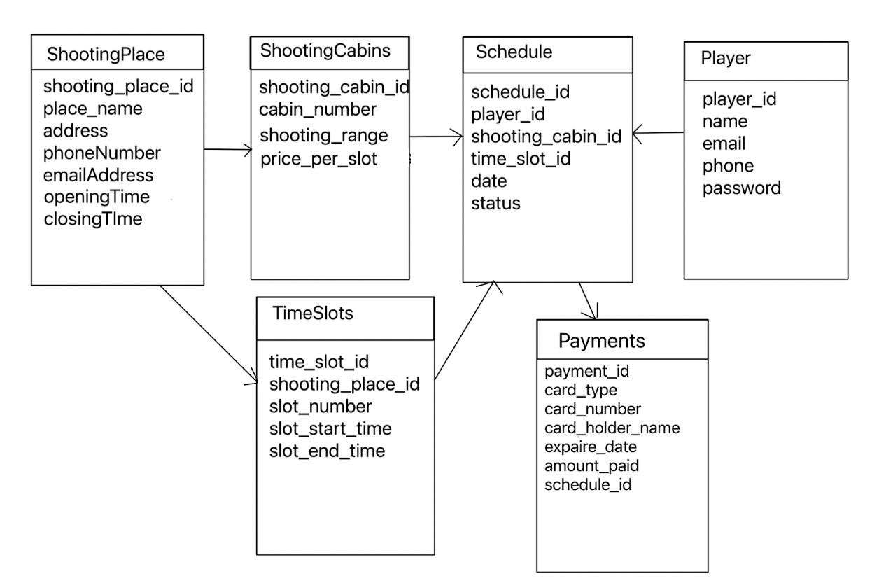
Database Model

Slide 8
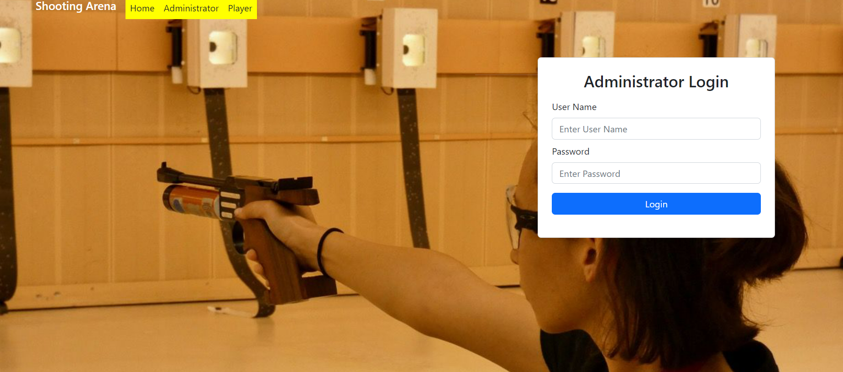
Admin login

Slide 9
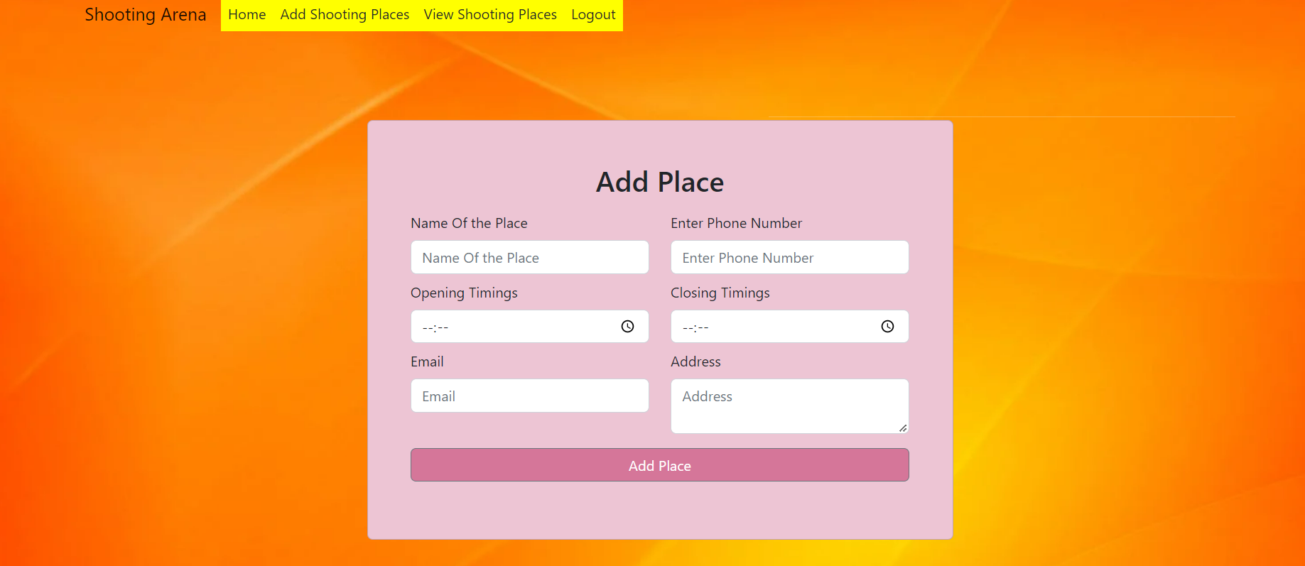
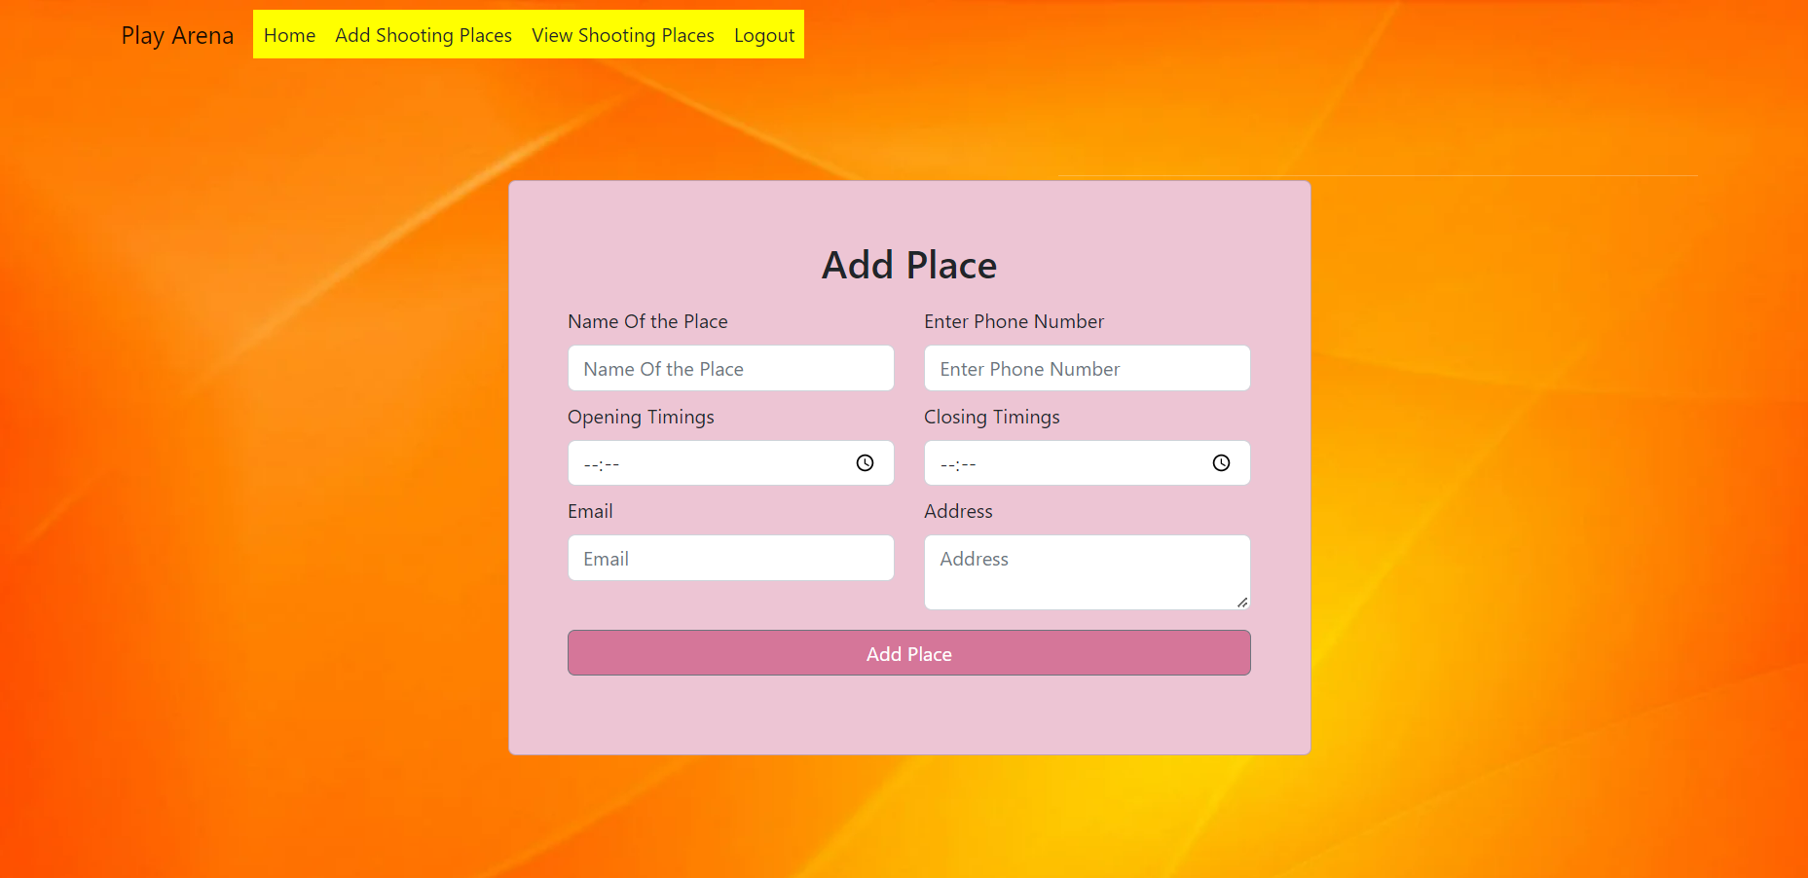
Add Shooting places

Slide 10
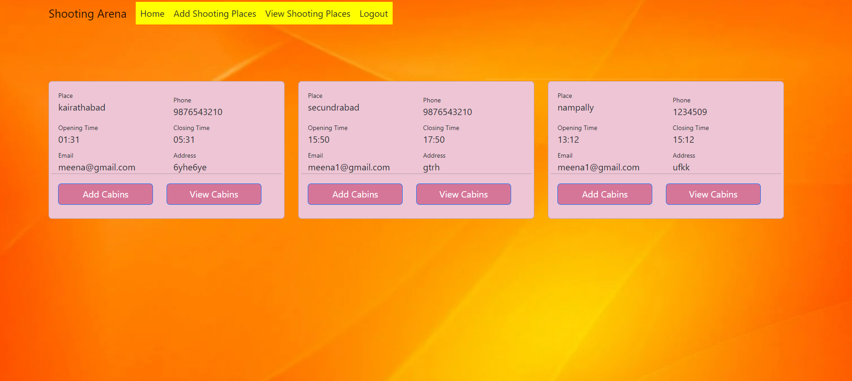
View Shooting places

Slide 11
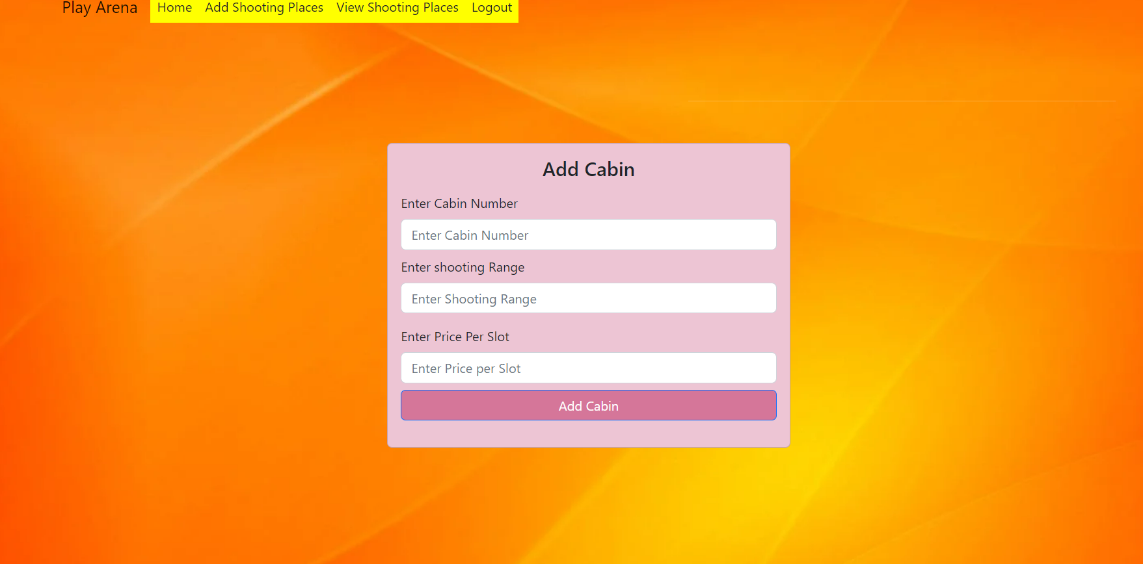
Add cabins

Slide 12
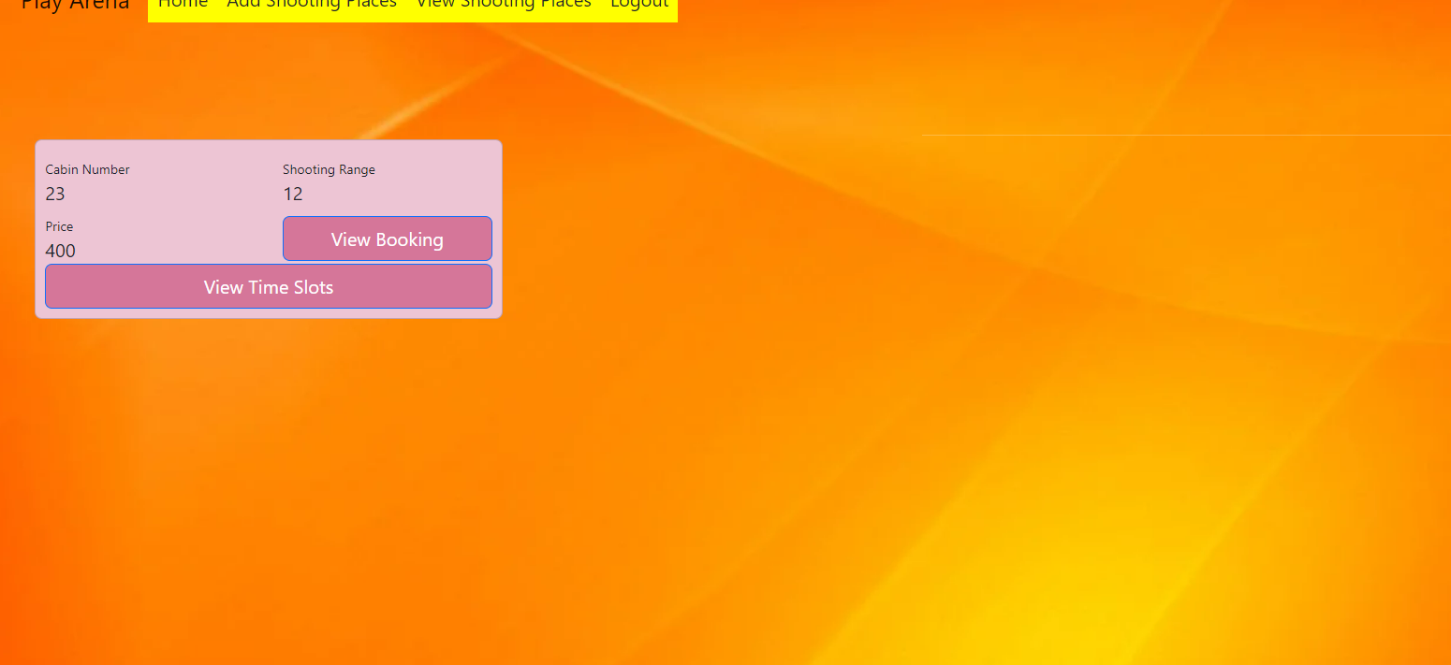
View cabins

Slide 13
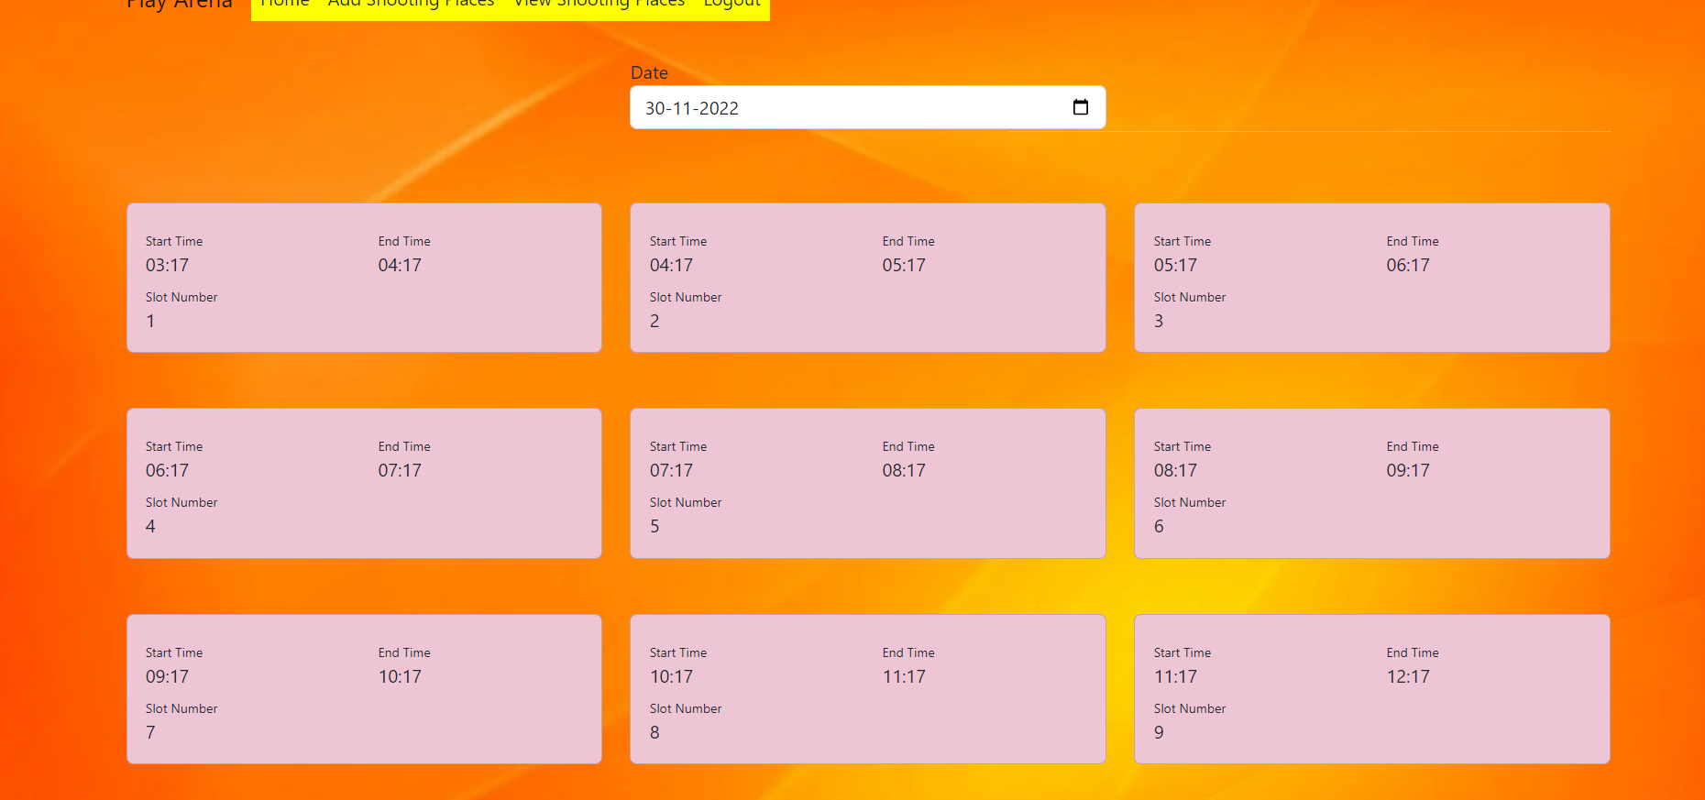
View Time slots

Slide 14
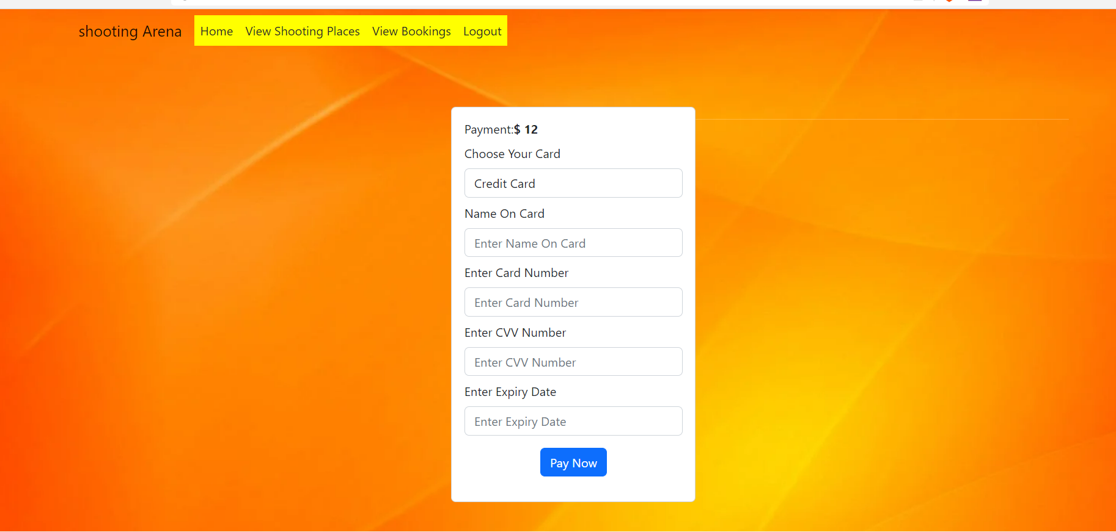
Add payment

Slide 15
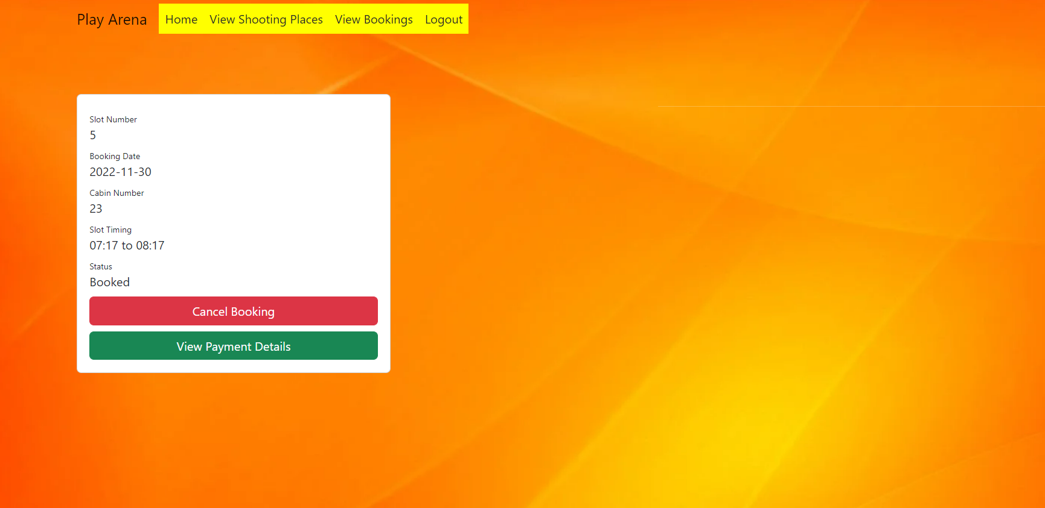
View Booking

Slide 16
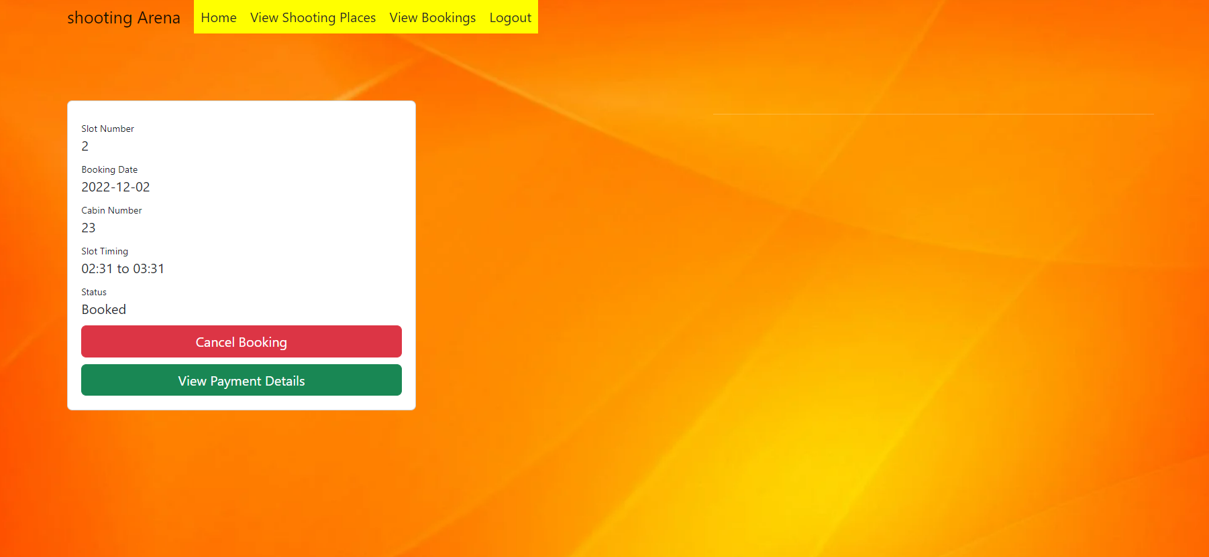

View payment

Slide 17


Slide 18


